Slide 1
10
DAYS OF
PRAYER
BACK TO THE ALTAR
Day 1
Where are you?
“Then the Lord God called to Adam and said to him, ‘Where are you?’ ”
Genesis 3:9 (NIV)
Key Focus:
God wants to reunite with us

Slide 2
10
DAYS OF
PRAYER
BACK TO THE ALTAR
Key thought
When God created Adam and Eve, they enjoyed time together each day. God warned them not to eat the fruit from the tree of knowledge of good and evil. But they chose to listen to the serpent. Adam and Eve disobeyed God and were afraid to meet Him. They knew they had done wrong and hid from God. But God loved them, called out for them and asked, "Where are you?" He knew where they were but gave them a chance to reveal themselves. They came out and He forgave them and covered their shame.
Prayer Time
Praying for a Reconnected Heart
Dear God, our heavenly Father, thank you for loving me even when I have done wrong. Thank you for never giving up on me. You promised that if I confess my sin, You will forgive me. Please give me a new heart to love you more and a desire to be with you each day.
In Jesus Name, Amen

Slide 3
10
DAYS OF
PRAYER
BACK TO THE ALTAR
Prayer Suggestion
Praise & Thanks Give thanks for specific blessings and praise God for His goodness
Confession Confess your wrongs and ask God for forgiveness
Guidance Ask God for wisdom to make right choices
Church Pray for the world church and our country
Requests Pray for the needs of church members, family and neighbors and all children’s needs to be met.
Sing Praise
SDAH 499 What a Friend We Have in Jesus
Change My Heart, O God
Jesus Loves Me
I Love You, Lord

Slide 4
10
DAYS OF
PRAYER
BACK TO THE ALTAR
Day 2
Key Focus:
God wants us to remember
Consecration and Commemoration
“And there he built an altar to the Lord, who had appeared to Him”
Genesis 12:7 (NIV)

Slide 5
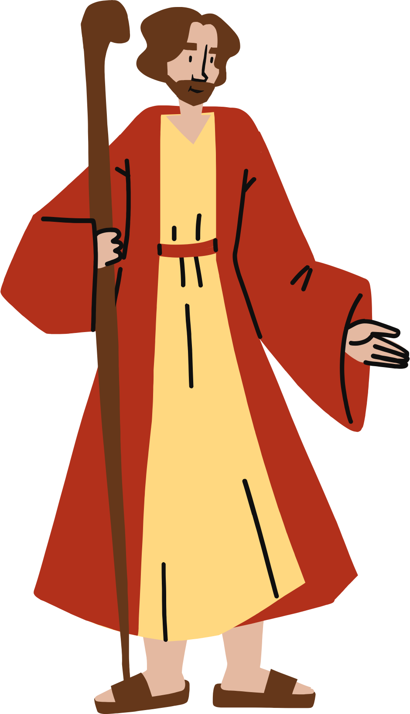
10
DAYS OF
PRAYER
BACK TO THE ALTAR
Key Thought
Altars have always represented places of dedication and remembrance. It is a symbol of a personal connection with God. God promised Abraham that He would be the father of many children and that He would give the Land of Canaan to his descendants. To honor and worship God, Abraham built an altar. This promise and act of worship was passed on to Abraham's son, Isaac and also to his grandson Jacob. Through their examples, the Israelites built altars to honor and worship God. We are also reminded to worship and talk to God daily.
Prayer Time
A place for Remembering
Dear God, our heavenly Father, thank you for all you have done for me. I want to give honor, praise and worship to you. Help me to remember your love and goodness and from now on to worship You each day. In Jesus Name, I pray, Amen

Slide 6
10
DAYS OF
PRAYER
BACK TO THE ALTAR
Prayer Suggestion
Praise & Thanks Give thanks for specific blessings and praise God for His goodness
Confession Confess your wrongs and ask God for forgiveness
Guidance Ask God for wisdom to make right choices
Church Pray for all SDA children and families to find God, put Him first in their lives, and follow Him.
Requests Pray for the Holy Spirit to guide in all children’s decision making and be blessed by their choices in cheerfully following God’s commands.
Sing Praise
SDAH #343 I Sing of My Redeemer
Give Thanks With a Grateful Heart
Count Your Blessings
I Want to Praise You Lord

Slide 7
10
DAYS OF
PRAYER
BACK TO THE ALTAR
Key Focus:
God wants us to start and end the day with Him
Day 3
Morning and Evening
“Stand every morning to thank and praise the Lord and likewise at evening”
1 Chronicles 23:30 (NIV)

Slide 8
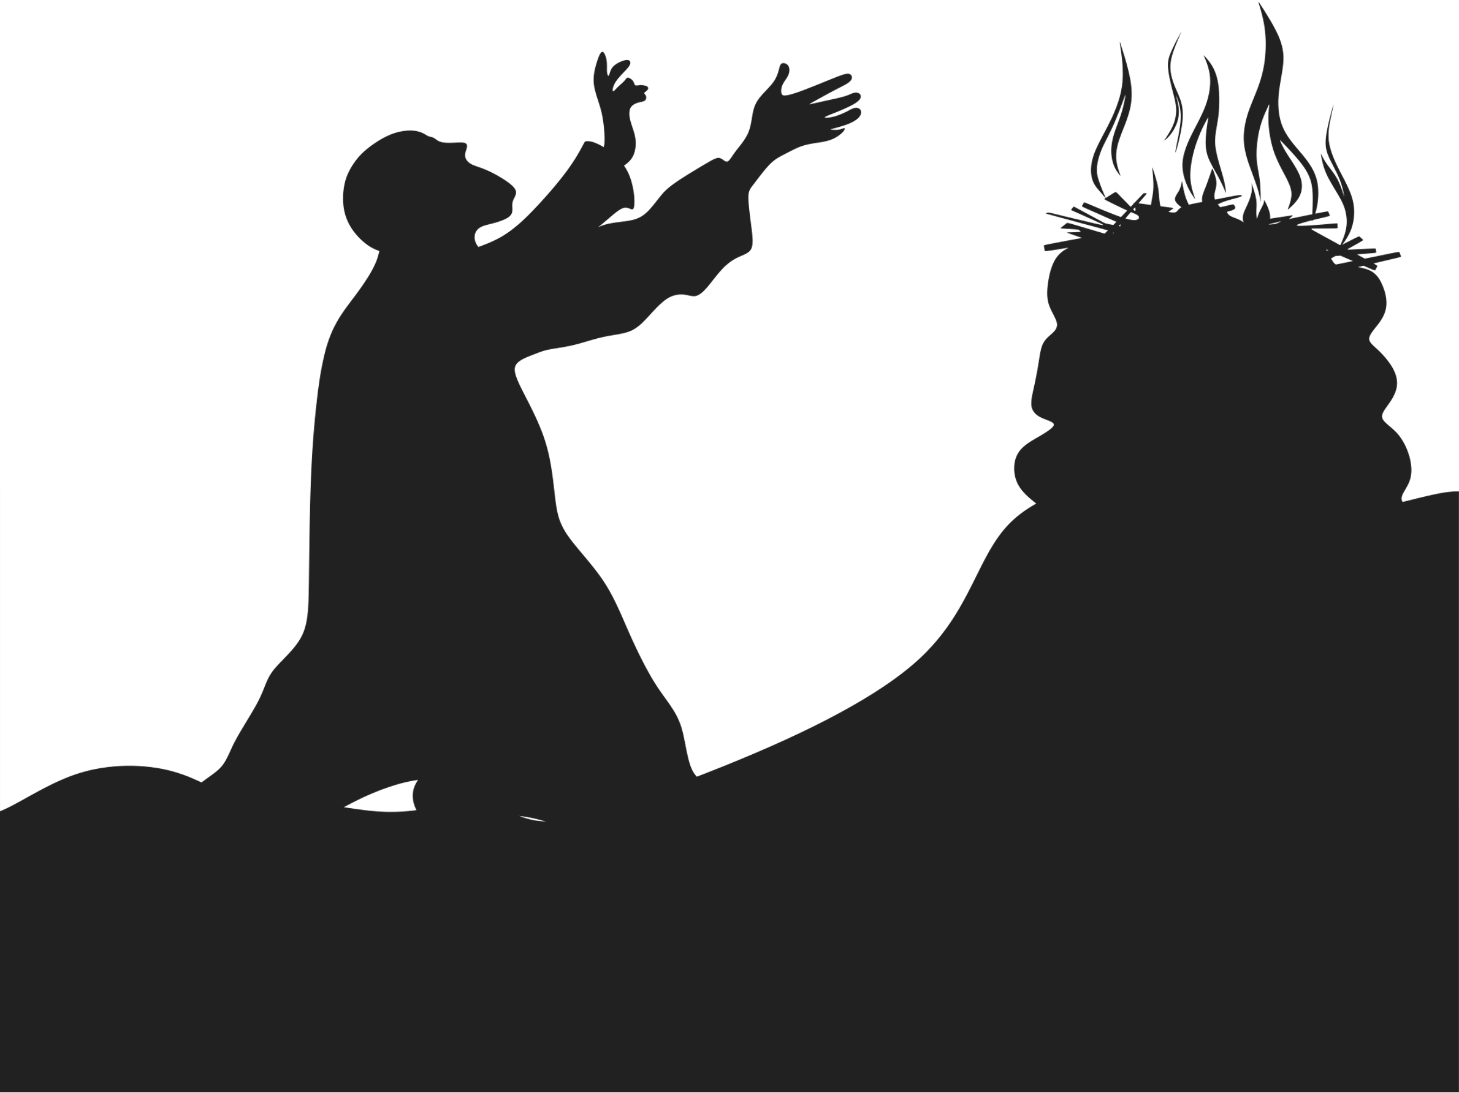
10
DAYS OF
PRAYER
BACK TO THE ALTAR
Key Thought
On the way to the Promised Land, the Israelites were wandering in the desert. God instructed them to be connected with Him by praying in the morning and evening each day. They needed God’s protection, courage and strength for the difficult journey. They were to worship and offer sacrifices on the altar in the morning and evening. It was a time of thanksgiving and repentance. It was also a special time for them to listen to God’s voice and receive His blessings. It is the same for us today. God wants to have that special time with us too.
Prayer Time
The Rhythm of Life
Dear God, our heavenly Father, thank you for reminding me that I can talk to You anytime. I know You love me so much and want to speak to me. Let me not be distracted by things that take me away from you. I need Your help to form the habit of starting and ending each day with You. May my ears be opened to hear Your voice and my heart be ready to follow You. In Jesus Name, Amen

Slide 9
10
DAYS OF
PRAYER
BACK TO THE ALTAR
Prayer Suggestion
Praise & Thanks Give thanks for specific blessings and praise God for His goodness
Confession Confess your wrongs and ask God for forgiveness
Guidance Ask God for wisdom to make right choices
Church Pray for the world church and our country
Requests Pray for the needs of church members, family and neighbors
Sing Praise
SDAH #482 Father, Lead me Day by Day
Whisper a Prayer
Open My Eyes, Lord
Walking with Jesus

Slide 10
10
DAYS OF
PRAYER
BACK TO THE ALTAR
Key Focus:
God wants us to go back to Him
Day 4
What Brings God Back
“So all the people came near to him. And he repaired the altar of the Lord that was broken down”
1 Kings 18:30 (NIV)

Slide 11
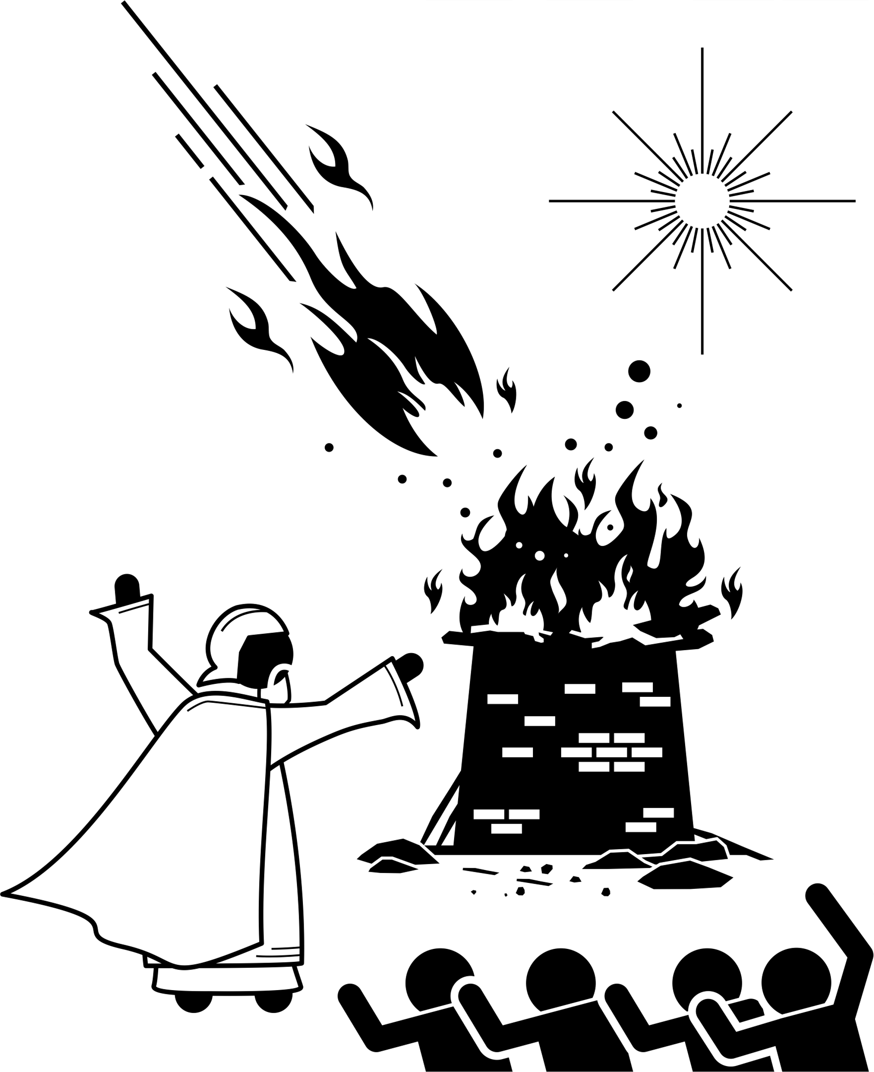
10
DAYS OF
PRAYER
BACK TO THE ALTAR
Key Thought
The evil King Ahab and his wife Jezebel ruled Israel. Because of their evil influence, many of God’s people have forgotten God and neglected worship. God called Elijah the prophet to rebuild the broken altars. When Elijah rebuilt the altars, he was showing the people the need to rebuild their relationship with God and to come back to Him. Elijah reminded the people to go back to worshipping the true God.
Prayer Time
Rebuild It and He will Come - Again!
Dear God, our heavenly Father, thank you for loving me even when I do wrong. You never leave me and You call me back to You. Give me a new heart and a desire to want to have that time alone with You. Help me resolve to worship you every day. In Jesus Name, Amen

Slide 12
10
DAYS OF
PRAYER
BACK TO THE ALTAR
Prayer Suggestion
Praise & Thanks Give thanks for specific blessings and praise God for His goodness
Confession Confess your wrongs and ask God for forgiveness
Guidance Ask God for wisdom to make right choices
Church Pray for the world church and our country
Requests Pray for the needs of church members, family and neighbors
Sing Praise
SDAH #500 Trust and Obey
I have Decided to Follow Jesus
I Shall Not Be Moved
Read your Bible and Pray Everyday

Slide 13
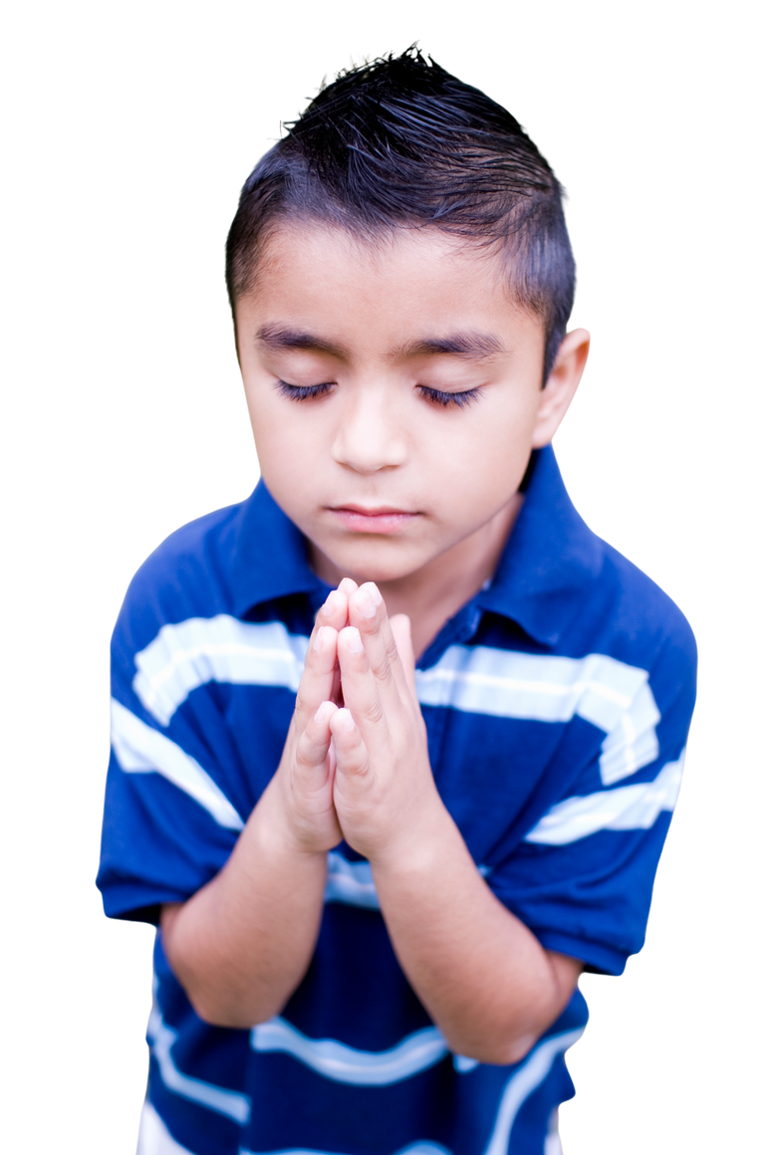
10
DAYS OF
PRAYER
BACK TO THE ALTAR
Day 5
Key Focus:
God wants us to put Him first each day
Jesus, The Early Riser
“But the hour is coming, and now is, when the true worshipers will worship the Father in spirit and truth;
for the Father is seeking such to worship Him”
John 4:23 (NIV)

Slide 14
10
DAYS OF
PRAYER
BACK TO THE ALTAR
Key Thought
When Jesus was on this earth, He woke up early in the morning before the sun rise. He would go to a quiet and secluded place to talk and to listen to His heavenly father. One day, after a full day of working and ministering to people, His disciples could not find Him. They searched for Him everywhere and when they finally found Him, they asked him where He was all that time. He reminded them that He came to earth to preach the gospel and bring salvation to people. He prayed for guidance, power and courage from His heavenly Father to carry out His mission each day.
Prayer Time
Early Will I Seek Thee
Dear God, our heavenly Father, forgive me for neglecting to spend time with You. Thank you for your patience. It is a privilege and honor for me to begin each day with you. Help me follow Jesus’ example of quiet time with You so that I can listen to Your direction. Please guide and lead me so that I will always be in line with Your purpose for me.
In Jesus Name, Amen

Slide 15
10
DAYS OF
PRAYER
BACK TO THE ALTAR
Prayer Suggestion
Praise & Thanks Give thanks for specific blessings and praise God for His goodness
Confession Confess your wrongs and ask God for forgiveness
Guidance Ask God for wisdom to make right choices
Church Pray for the world church and our country
Requests Pray for the needs of church members, family and neighbors
Sing Praise
SDAH #539 I will Early seek the Savior
SDAH#305 Give Me Jesus
Give Me Oil in My Lamp
He’s Able
Into My Heart
Thy Word is a Lamp Unto My Feet

Slide 16
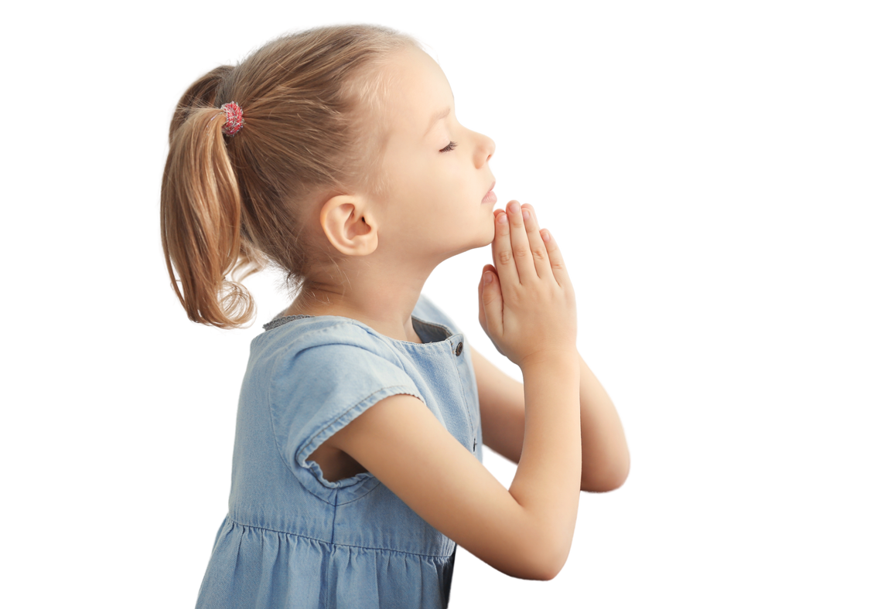
10
DAYS OF
PRAYER
BACK TO THE ALTAR
Key Focus:
God wants us to end the day with Him
Day 6
The All-Night Prayer Warrior
“Now it came to pass in those days that He went out to the mountain to pray, and continued all night in prayer to God”
Luke 6:12 (NIV)

Slide 17
10
DAYS OF
PRAYER
BACK TO THE ALTAR
Jesus was known to spend the whole night praying. On one occasion, He stayed up all night to pray before choosing 12 men to be His disciples. It was not easy to choose men who would continue the work when He returned to heaven. After He had chosen His disciples, He prayed for them. He also prayed for those who were in need. Do you know that Jesus also prayed for Himself? He asked God for wisdom and strength. Prayer was His source of strength to overcome temptations and challenges that were ahead of Him.
Key Thought
Prayer Time
Ending the Day with God
Dear God, our heavenly Father, teach us how to pray and make prayer time a priority. When the day ends, I just want to thank you for all that you’ve done for me. I could not have made it through the day without You. Thank you for Your protection and guidance. Help me to make right choices for I am nothing without You. I know You want the best for me, and I can always depend on You. In Jesus Name, Amen

Slide 18
10
DAYS OF
PRAYER
BACK TO THE ALTAR
Prayer Suggestion
Praise & Thanks Give thanks for specific blessings and praise God for His goodness
Confession Confess your wrongs and ask God for forgiveness
Guidance Ask God for wisdom to make right choices
Church Pray for the world church and our country
Requests Pray for the needs of church members, family and neighbors
Sing Praise
SDAH #469 Leaning on the Everlasting Arms
In Moments Like This
His Sheep Am I
My Peace I Give Unto You

Slide 19
10
DAYS OF
PRAYER
BACK TO THE ALTAR
Key Focus:
God wants us to have personal and family worship
Day 7
A Church That Worships
“Come, let us worship and bow down; let us kneel before the Lord our Maker”
Psalm 95:6 (NIV)

Slide 20
10
DAYS OF
PRAYER
BACK TO THE ALTAR
Key Thought
In Bible times, the Israelites erected altars to worship God, to give honor, and to praise. Fathers and Mothers should always pray for themselves and their children. God instructs fathers to be the priest in the home where he leads in family worship, every morning and evening. The family unit, which consists of father, mother and children, are to gather at regular times to pray together. God abides in a home where families gather each day to worship and sing praises to Him. He sends angels to homes where hymns are sung and prayers are uttered.
Prayer Time
Our Most Urgent Need
Dear God, our heavenly Father, please forgive me for not honoring You and giving You first place in my heart. I praise and worship You for You are my God, Creator of the Universe and the Mighty King. Thank you for blessing me with a loving family. Help us to make You the center of our home. Give us a desire to come together to praise and to honor You daily and be transformed into the image of Jesus. In Jesus Name, Amen

Slide 21
10
DAYS OF
PRAYER
BACK TO THE ALTAR
Prayer Suggestion
Praise & Thanks Give thanks for specific blessings and praise God for His goodness
Confession Confess your wrongs and ask God for forgiveness
Guidance Ask God for wisdom to make right choices
Church Pray for the world church and our country
Requests Pray for the needs of church members, family and neighbors
Sing Praise
SDAH#483 I need Thee Every Hour
SDAH#672 Spirit of the Living God
I love You Lord
Unto Thee, O Lord
Surely the Presence of the Lord

Slide 22
10
DAYS OF
PRAYER
BACK TO THE ALTAR
Day 8
“Fear God and give glory to Him, for the hour of His judgement has come; and worship Him who made heaven and earth, the sea and springs of water”
Revelation 14:7 (NIV)
Worship and The Three Angels' Message
Key Focus:
God wants us to be watchful and ready

Slide 23
10
DAYS OF
PRAYER
BACK TO THE ALTAR
Key Thought
In the book of Revelation, John wrote about Jesus coming. There were three flying angels with important messages for the people. The first angel reminds us to worship God for He is coming soon, the second angel predicted the fall of Satan's deception, and the third angel warns us to turn away from the enemy. Our church proclaims the End-Time Messages through the three angels, because He wants everyone to repent and worship Him before it is too late. His greatest desire is for everyone to be saved and be reunited with Him in heaven.
Devotional Life and the End-time Message
Our dear heavenly Father, Mighty Creator God, I come humbly before You. You are the God that is worthy of my praise and worship. Fill me with Your Holy Spirit that I may be like You. I want to be ready when Jesus comes. I want to stay close to You each day. Keep me faithful and have the courage to tell others about You.
In Jesus Name, Amen
Prayer Time

Slide 24
10
DAYS OF
PRAYER
BACK TO THE ALTAR
Prayer Suggestion
Praise & Thanks Give thanks for specific blessings and praise God for His goodness
Confession Confess your wrongs and ask God for forgiveness
Guidance Ask God for wisdom to make right choices
Church Pray for the world church and our country
Requests Pray for the needs of church members, family and neighbors
Sing Praise
SDAH#373 Seeking the Lost
SDAH#213 Lift Up the Trumpet
For God so Loved the World
I Will Make You Fishers of Men
With Christ in the Vessel

Slide 25
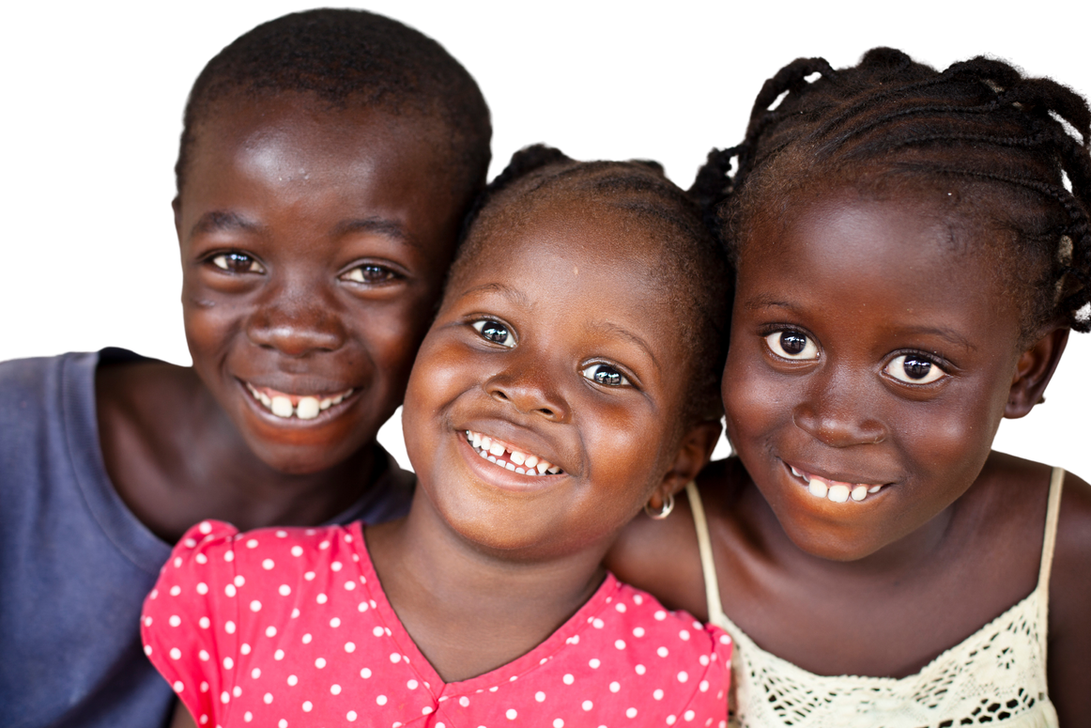
10
DAYS OF
PRAYER
BACK TO THE ALTAR
Day 9
Don't Lose Your Mind
Key Focus:
God wants us to keep our hearts and mind pure
“Keep your heart with all diligence, for out of it spring the issues of life”
Proverbs 4:23 (NIV)

Slide 26
10
DAYS OF
PRAYER
BACK TO THE ALTAR
Key Thought
Many bad things are happening around us and we see evil people who are doing bad things. This happens when they do not have God in their hearts. They allow evil thoughts to fill their minds by doing things that are against God’s instructions. Our minds control our words and actions. When we fill our minds with good thoughts and focus on God, we allow God to come into our hearts. Spending time in praise, prayer and reading our Bible and sharing His love to others keeps us close to Him. Through our loving ways and lifestyle, people are able to see God’s love in us.
Prayer Time
Worship Keeps the Mind
Our dear heavenly Father, King of the Universe. Forgive me for having evil thoughts. Help me from today onwards to allow You into my mind and heart. I want You to live in my heart so that everything else will be secondary. Take away whatever things that will distract me from being with You. Help me to make right choices and keep my heart pure. Guard and protect me from the evil one.
In Jesus Name, Amen

Slide 27
10
DAYS OF
PRAYER
BACK TO THE ALTAR
Prayer Suggestion
Praise & Thanks Give thanks for specific blessings and praise God for His goodness
Confession Confess your wrongs and ask God for forgiveness
Guidance Ask God for wisdom to make right choices
Church Pray for the world church and our country
Requests Pray for the needs of church members, family and neighbors
Sing Praise
SDAH #311 I Would Be like Jesus
SDAH #327 I’d Rather Have Jesus
Seek Ye First
You are My All in All
Into My Heart
Create in Me a Clean Heart

Slide 28
10
DAYS OF
PRAYER
BACK TO THE ALTAR
Key Focus:
God calls me to share His Love to others
Day 10
I Will Go!
“Whom shall I send,
and who will go for Us?”
Then I said, Here am I! Send me” Isaiah 6:8 (NIV)

Slide 29
10
DAYS OF
PRAYER
BACK TO THE ALTAR
Key Thought
God showed Prophet Isaiah a vision of Himself on the throne. It was a beautiful and glorious picture and yet Prophet Isaiah felt that he was unworthy to be in God’s magnificent presence. However, God revealed this vision to call Isaiah to spread the message of love and warning at the same time. God is worthy of our worship and He wants to be with us in heaven forever. This message must be shared with others before it is too late. God calls each of us to be His messengers. But first, we have to turn back to Him in worship and prayer. When we do that, we are empowered to go. We must go now for He is coming very soon.
Prayer Time
Empowered to Finish the Work
Our dear heavenly Father, Mighty Creator God, thank you for calling me to serve You and share this important message. Even though I may be young, I can still do my part. Please forgive me for my mistakes and not following Your call. Your love is not just for me but for everyone. You want all of us to be with You in heaven. Please give me courage and wisdom to be Your messenger in sharing Your love.
In Jesus Name, Amen

Slide 30
10
DAYS OF
PRAYER
BACK TO THE ALTAR
Prayer Suggestion
Praise & Thanks Give thanks for specific blessings and praise God for His goodness
Confession Confess your wrongs and ask God for forgiveness
Guidance Ask God for wisdom to make right choices
Church Pray for the world church and our country
Requests Pray for the needs of church members, family and neighbors
Sing Praise
SDAH #330 Take My Life and Let it Be
SDAH #618 Stand Up, Stand Up for Jesus
Father, I Adore You
Pass It On
Make Me a Servant
This Little light of Mine

